Slide 1
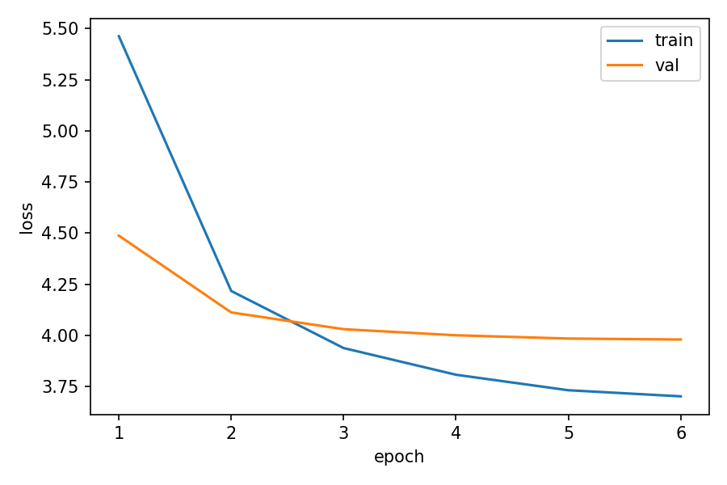
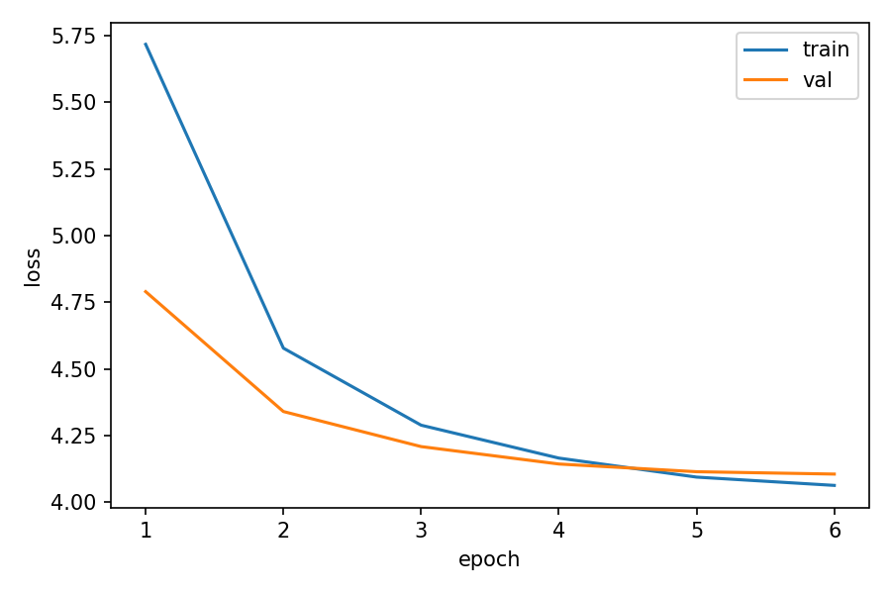
基准：
loss_curve_baseline_dmodel256_layer4_dff1024_head8_genre5
loss_curve_baseline_dmodel256_layer4_dff1024_head8_genre7

Slide 2
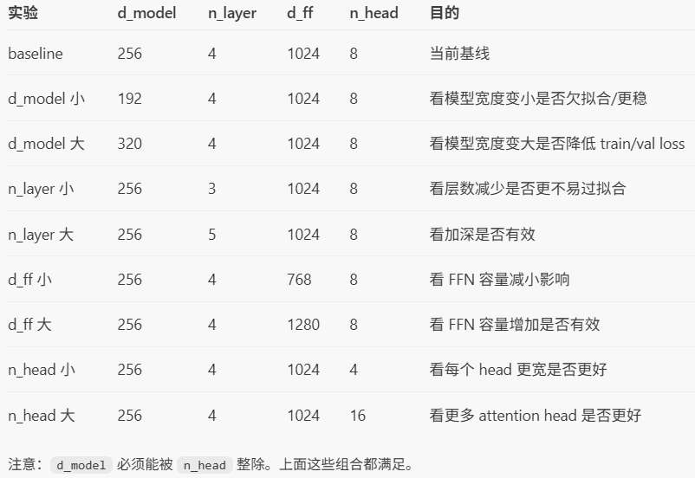

Slide 3
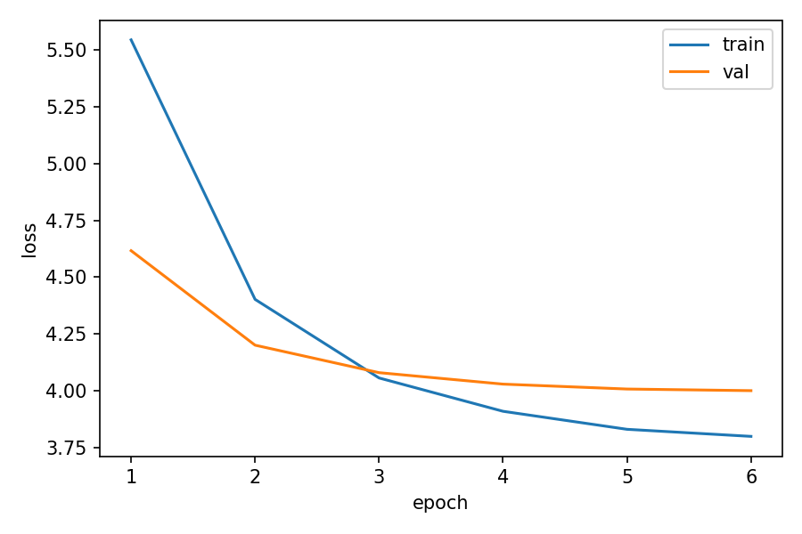
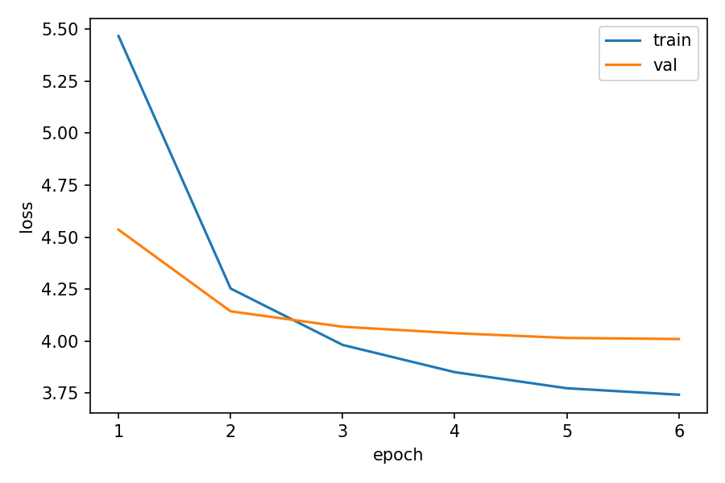
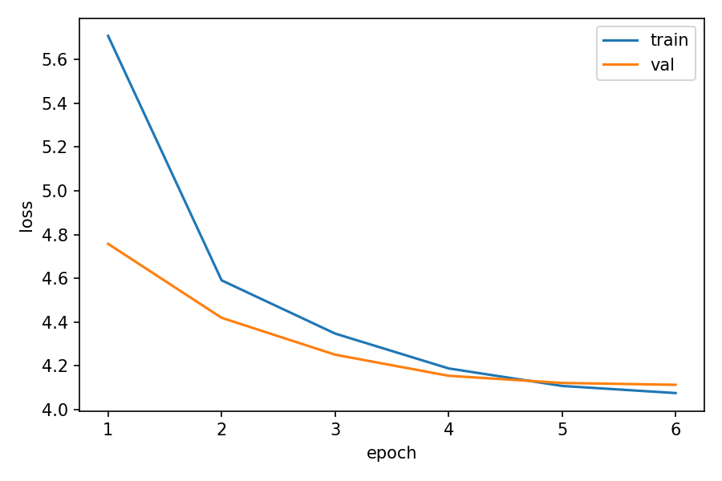
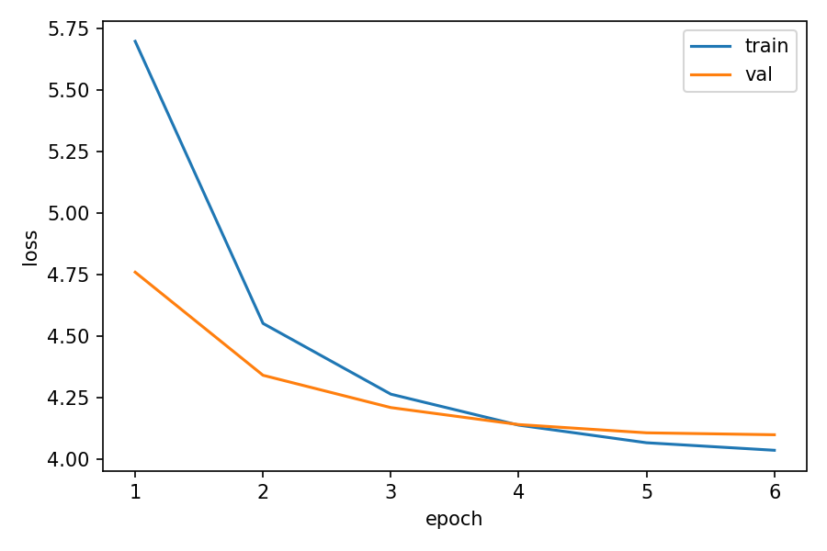
n_head__n_head_small_4__genre5__loss_curve
n_head__n_head_large_16__genre5__loss_curve
n_head__n_head_small_4__genre7__loss_curve
n_head__n_head_large_16__genre7__loss_curve

Slide 4
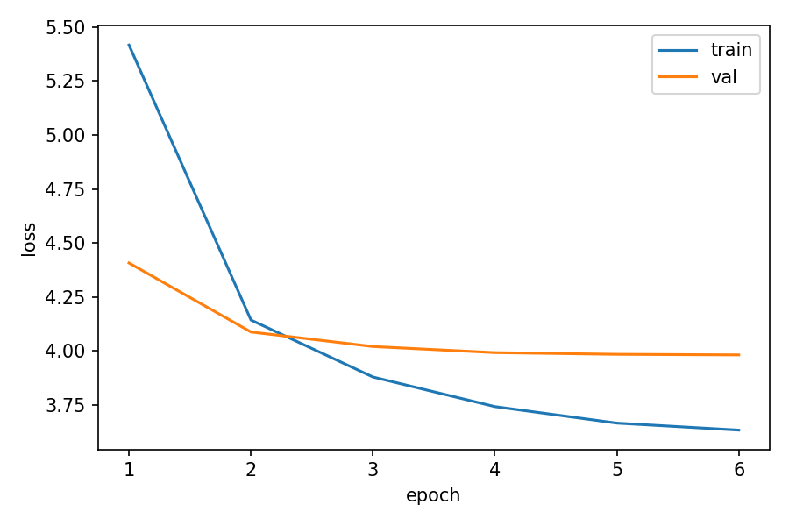
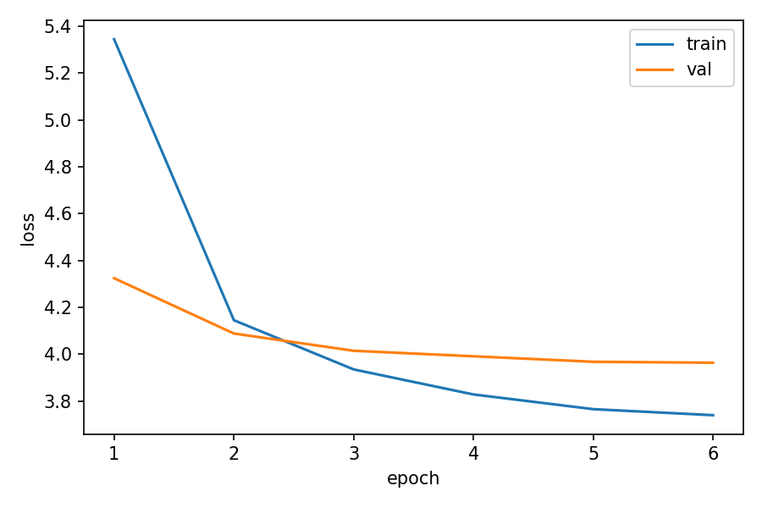
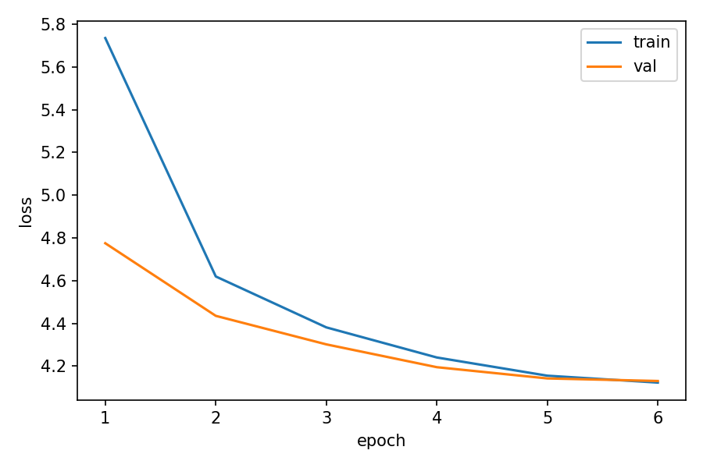
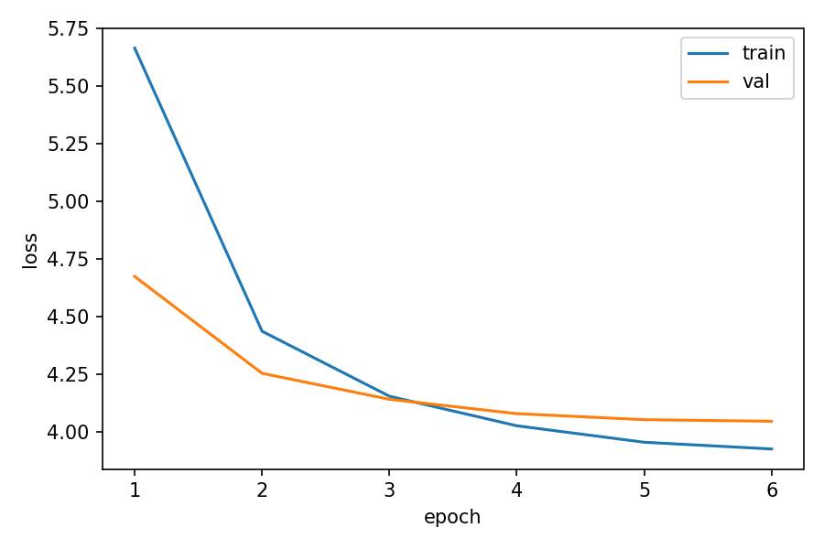
n_layer__n_layer_small_3__genre5__loss_curve
n_layer__n_layer_large_5__genre5__loss_curve
n_layer__n_layer_small_3__genre7__loss_curve
n_layer__n_layer_large_5__genre7__loss_curve

Slide 5
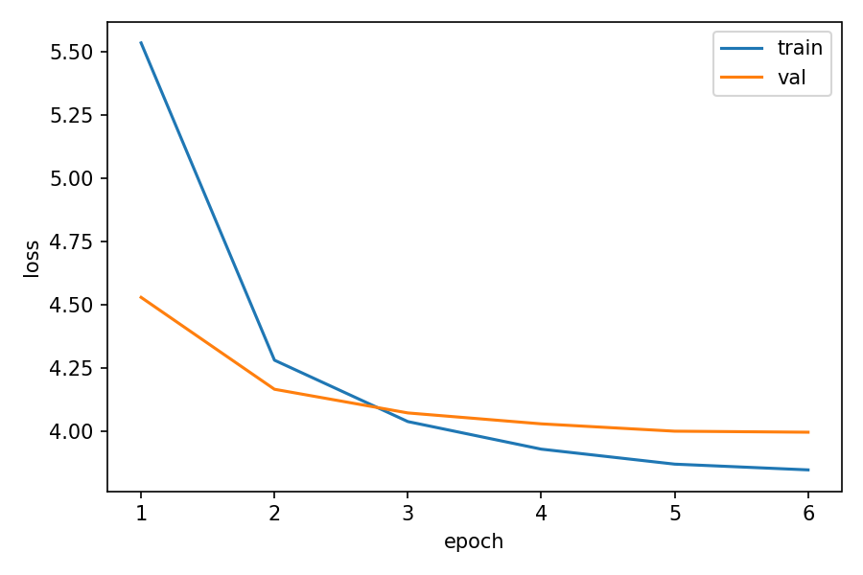
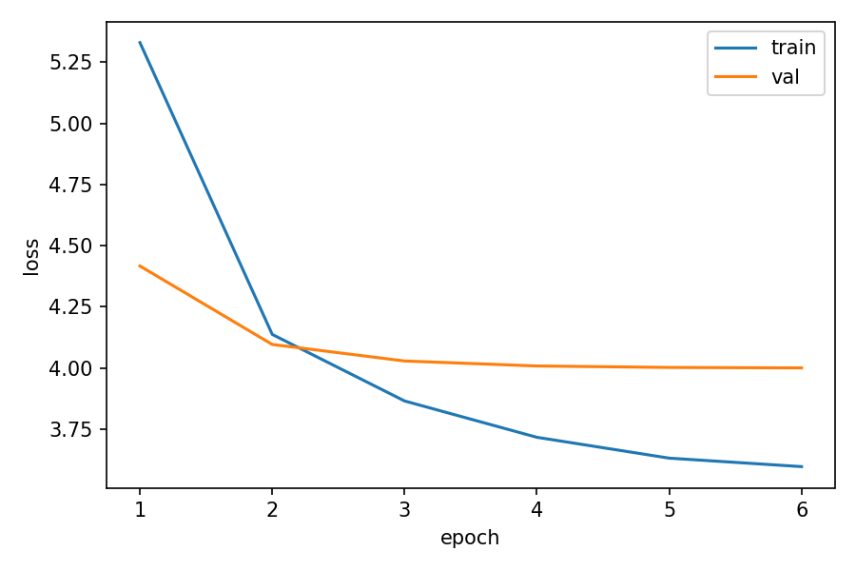
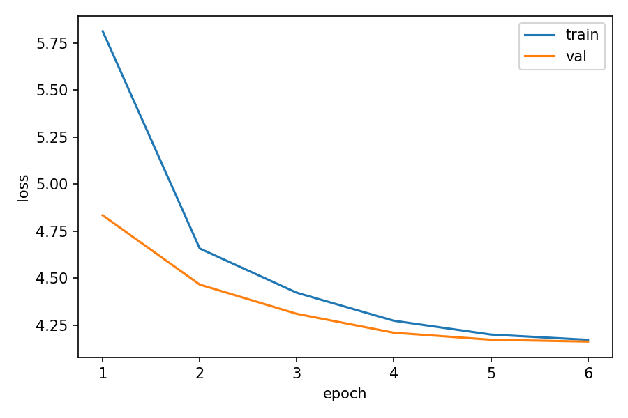
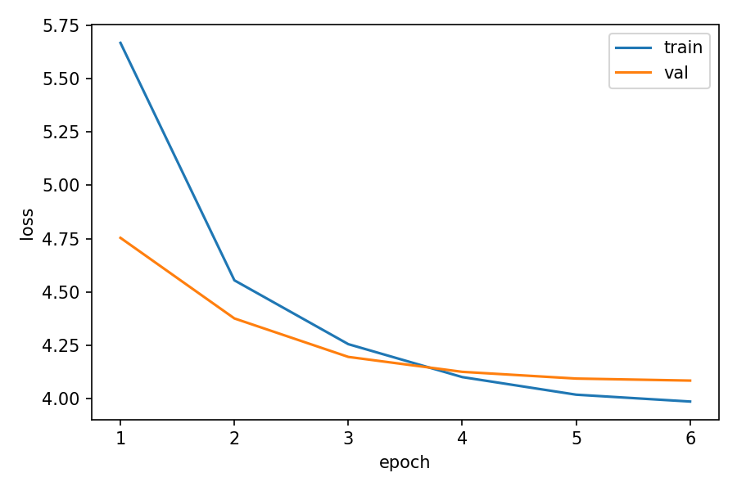
d_model__d_model_small_192__genre5__loss_curve
d_model__d_model_large_320__genre5__loss_curve
d_model__d_model_small_192__genre7__loss_curve
d_model__d_model_large_320__genre7__loss_curve

Slide 6
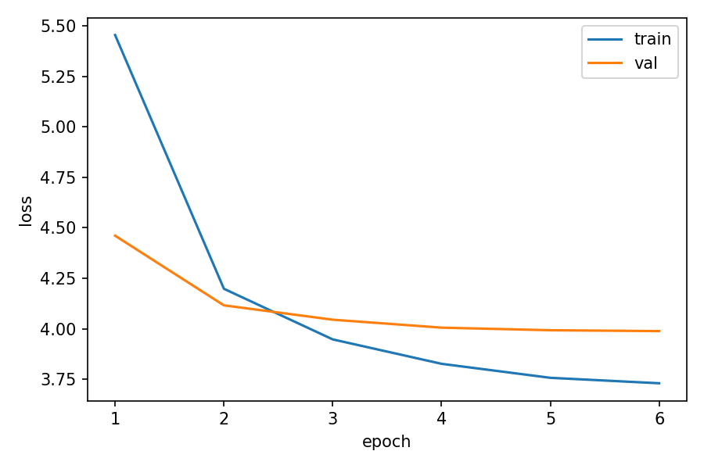
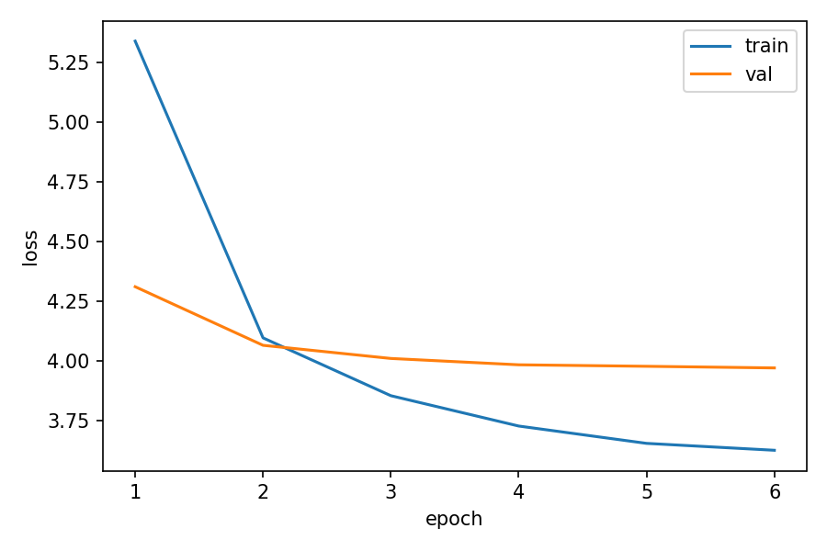
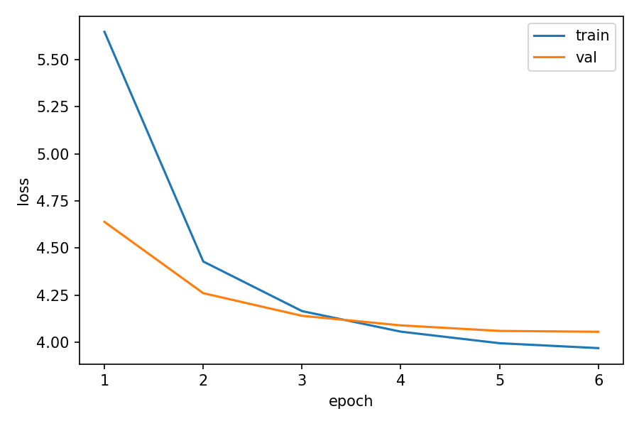
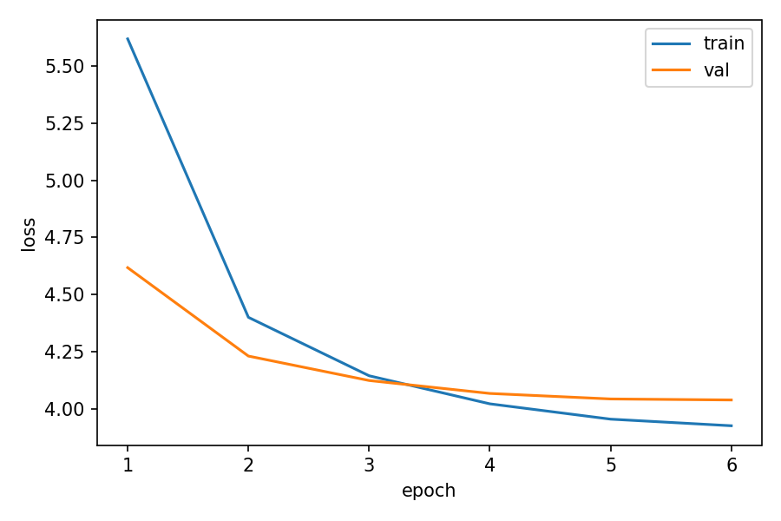
d_ff__d_ff_small_768__genre5__loss_curve
d_ff__d_ff_large_1280__genre5__loss_curve
d_ff__d_ff_small_768__genre7__loss_curve
d_ff__d_ff_large_1280__genre7__loss_curve

